Slide 1
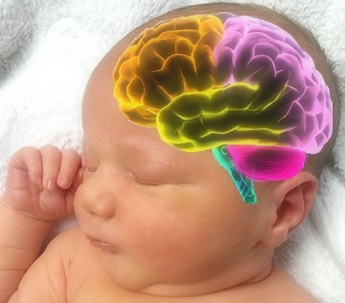
Brain Development

Slide 2
Essential Question: How does a baby’s brain develop and what can I do to help it?

Slide 3
Child development is a continuum.
Continuum: A continuous sequence or progression. A developmental continuum outlines the predictable order, or expected progression of skills.
Example:

Slide 4
Abilities Continuum
Think to yourself… how well can you sew?
Not at all
Thread a needle
Make a pillow
Work a sewing machine
Make a dress
Pro Status

Slide 5
1 2 3 4 5 6 7 8 9 10
1= Low Skill Level 10= High Skill Level

Slide 6
Child development is nature & nurture
Nature: Genetics
Example:
Nurture: Environment
Example:

Slide 7
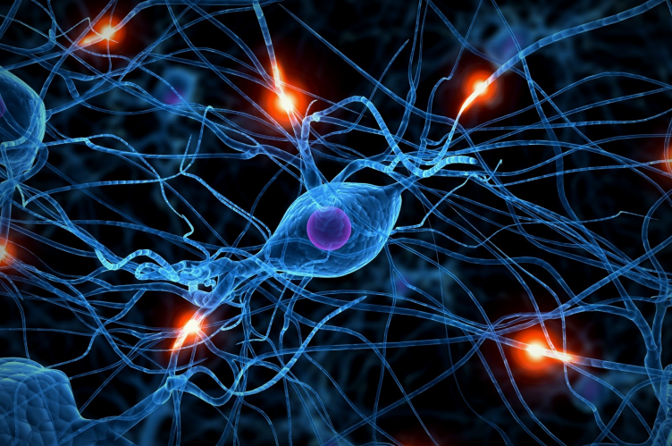
You are born with 100 billion brain cells ---rapidly form connections for the first few years of life

Slide 8
Neural Pathways: A series of connected nerves along which electrical impulses travel in the body.

Slide 9
Neural Pathways…
Are difficult to form the first time
Example:
Are strengthened through experience
Example:
Pruned when not used
Example:

Slide 11
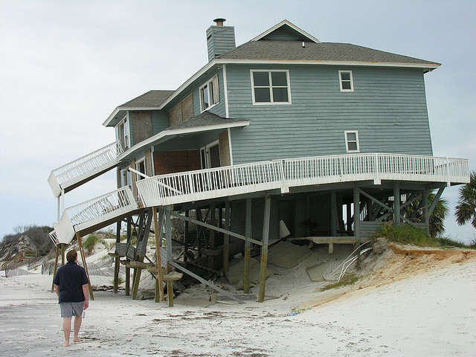
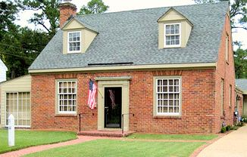
The pathways you create as a child will build the foundation of your brain for the rest of your life

Slide 12
Building Bridges
http://learningandtheadolescentmind.org/resources_02_learning.html (3:15)

Slide 13
Neural Plasticity: The brain’s ability to reorganize itself by forming new neural pathways. The brain is more “plastic” as a child.
Example:

Slide 14
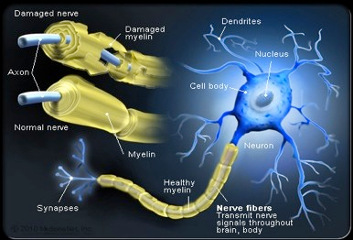
Myelin Sheath: A fatty, protective layer that coats your neural pathways.

Slide 15
Myelin Sheath
“Sets” you in your ways
Makes adulthood hard if you don’t have a good foundation

Slide 16
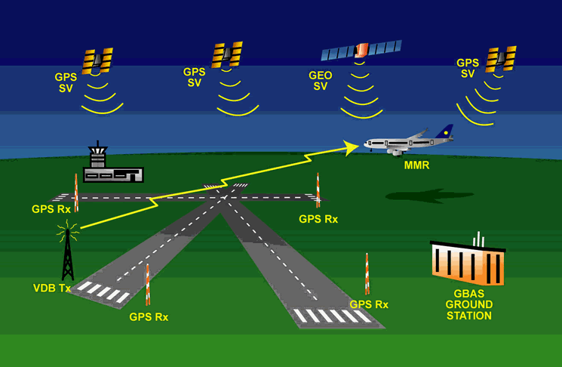
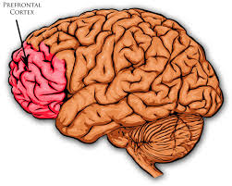
Executive Functions
Prefrontal Cortex of the brain (Front)
“Air Traffic Control System” enabling the brain and body to deal with multiple information and distractions at one time.

Slide 17
Working Memory, Inhibitory Control, Mental Flexibility
Working Memory – I remember what I should be doing
Inhibitory Control- I really want to look at my phone but then Ms. Hampel will take it
Mental Flexibility- The phone rings (
Is associated with good child outcomes, success in school, and life-long benefits
Executive Function http://developingchild.harvard.edu/key_concepts/executive_function/

Slide 18
Stress: The response to demand or threat.

Slide 19
Positive Stress: Moderate, short-lived stress
Example:

Slide 20
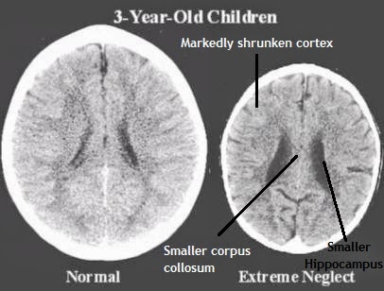
Toxic Stress: Chronic, strong, unrelenting stress without a supportive adult
Example:

Slide 21
Tolerable Stress: Chronic, strong, unrelenting stress with a supportive adult
Example:

Slide 22
TOXIC Stress will prune neural pathways!

Slide 24
Screen Time & Children
Screen time (TV, video games, smart phones, computers, DVDs, etc.) is associated with problems with executive functions such as attention, concentration, impulsivity, imagination, planning, language and social skills. Higher risk of being overweight, prejudiced, sedentary, aggressive, and/or unable to distinguish between fantasy and reality.
No screen time for children under 2. Older children, no more than 1-2 hours per day
Even “educational” videos for babies (baby Einstein) actually do the opposite and delay intellectual and language development.

Slide 25
Summary: What can you do to help neural pathways form in the Tiny Timberwolves Preschoolers? What can you do to help neural pathways not be pruned?

