Slide 1
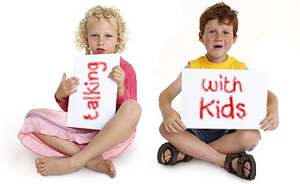
Conversations with Kids!
How to talk to children

Slide 2
Receptive language
The language that you understand/comprehend when it is spoken to you

Slide 3
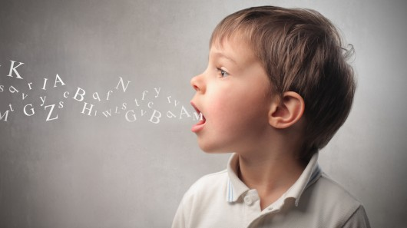
Expressive Language
The language you are able to communicate/speak with to others.
***Almost always less advanced than one’s receptive language

Slide 4
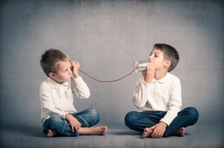
Conversation Unspoken Rules
#1: Listening to what the other is saying (quiet mouths, open ears)
#2: Body Language (facing them, some eye contact, nodding, smiling, etc.)

Slide 5
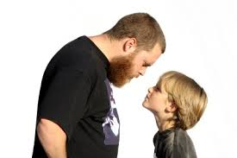
Talking to…where???
ALWAYS get down to the eye/head level of a child when you speak with them.
Respectful: Shows you care about the conversation
Hearing: Easier to hear when someone isn’t literally talking over one’s head…easier for you to hear them too
Eye-contact: They know you are talking to them, and learn to use eye-contact (esp. for kiddos with ASD)
WAY less awkward.
YES!
NO!

Slide 6
Eye Contact…Good?
Occasional eye contact is an important part of conversation. Someone knows you are speaking to them when you look them in the eye—otherwise they might not think you’re speaking to them
HOWEVER, too much eye contact is unnerving. (Staring without blinking is creepy…humans blink, robots don’t.)
In some cultures children are raised to not meet an adult’s gaze, so be careful when requesting a child to look you in the eye
Children with ASD often feel very uncomfortable with looking in another person’s eyes. Good to practice with them, but not force

Slide 7
Open Ended/Closed Ended Questions
Open ended questions are the ones with many possible answers (what is your favorite snack? Where do you want to go for our next field trip?)
Closed ended questions only have a specific answer the questioner is looking for from the questionee. (what is 2 + 2? What is the color of an eggplant?)
Open ended questions are better for kids, it puts much less pressure on them and allows for creativity
Closed ended questions can be conversation stoppers. If they feel they are being quizzed…they might not like you ☺
AND ALWAYS…we ask kids WAY too many questions. Try to limit your questions and see if they speak with you more…

Slide 8
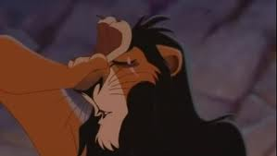
Information Talk
Describe what is going on to the child
Definitely do this instead of just firing away questions if your buddy isn’t talking to you
This will make you feel either insane or really dumb.
But it works so do it when you can, anyway!
Hampel will do some examples now. So embarassing…but it really works with kids. Promise!!!

