Slide 1
Valuing Each Child and Their Family

Slide 2
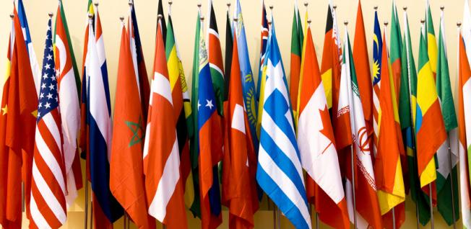
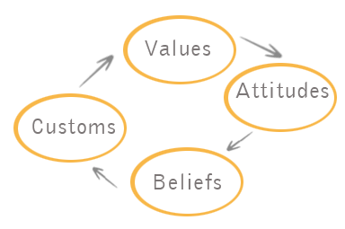
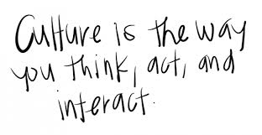
Culture is an integrated pattern of knowledge, beliefs and behavior that weaves a group of people together. These patterns and beliefs guide children in how to behave and interact within their family and community.

Slide 3
Is the acquired pair of glasses through which we see life.
-Mrarek A. Morocco
You don't have to burn books to destroy a culture. Just get people to stop reading them.
~Ray Bradbury
A nation's culture resides in the hearts and in the soul of its people.
--Mahatma Gandhi
We seldom realize, for example that our most private thoughts and emotions are not actually our own. For we think in terms of languages and images which we did not invent, but which were given to us by our society.”
― Alan W. Watts
https://www.youtube.com/watch?v=m8pbmbfeoHs

Slide 4
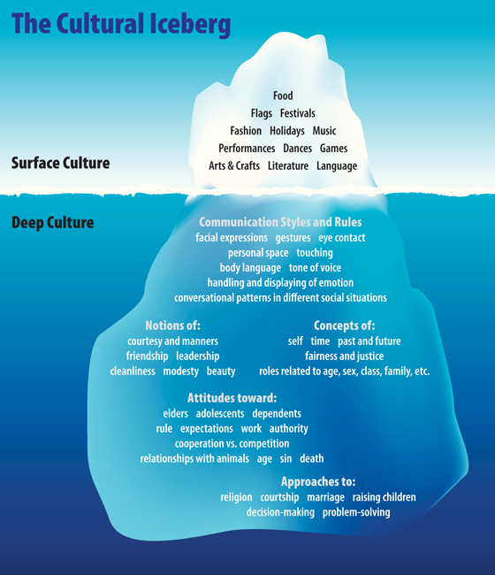

Slide 5
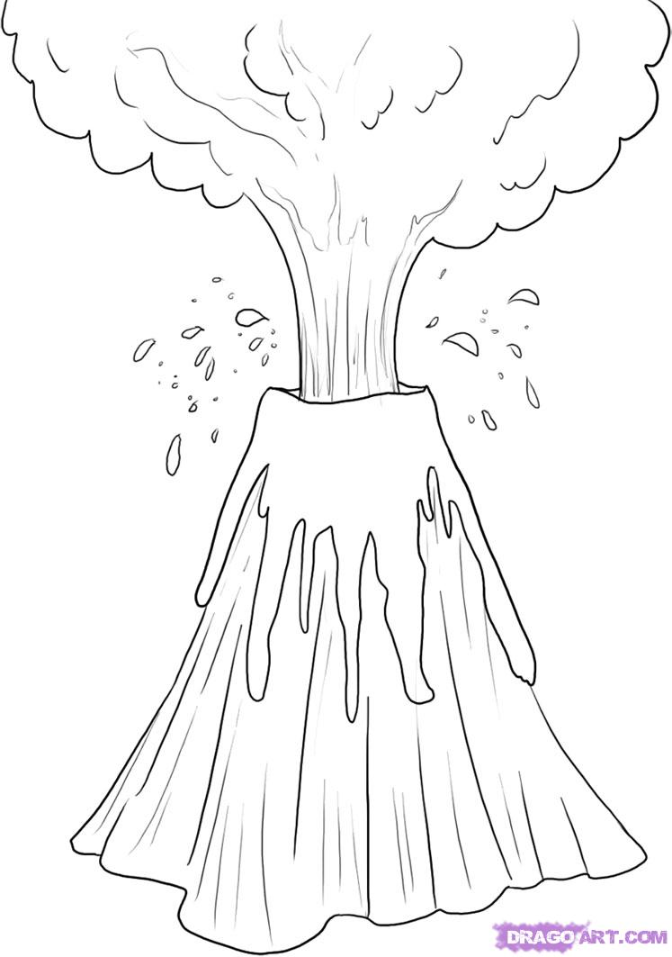
Surface Culture
Deep Culture
Language Values Showing emotion
Extended family relationships
Work (who does what, where)
Housing arrangements Religion
Community connection Health Care
Intergenerational relationships
Historic events gender roles
Role of children

Slide 6
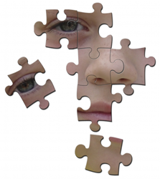
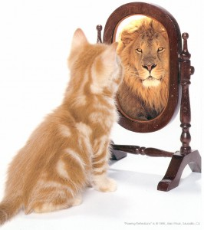
Self Identity
Children need to develop a positive self-identity in order to thrive.
Children start developing a sense of who they are at birth.
Relationships with family members, other adults and children, and friends and members of their community all play a key role in building their identities.

Slide 7
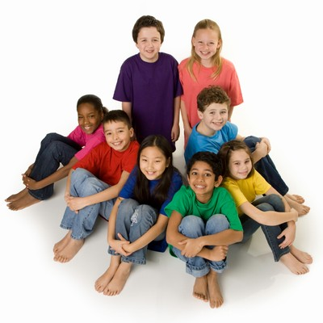
Components of Human Diversity
Language:
Home Language
English language learners
Tribal language revitalization
Temperament:
Flexible
Fearful/Cautious
Feisty
Religion:
Identity
Traditions
Holidays
Age:
Of children
Of others in family
Gender:
Sexism
Unrealistic assumptions
Sexual orientation
Family History:
National Origin
Indigenous
Immigrants
Enslavement
Incarceration
Holocaust survival
Race/ethnicity:
Mono-racial
Multi/biracial
Tribal identity
Ability:
Disabilities
Giftedness
Typical development
Social Class:
Poor, working class, middle class, owning class
Income level
Job(s) of family members; unemployment

Slide 8
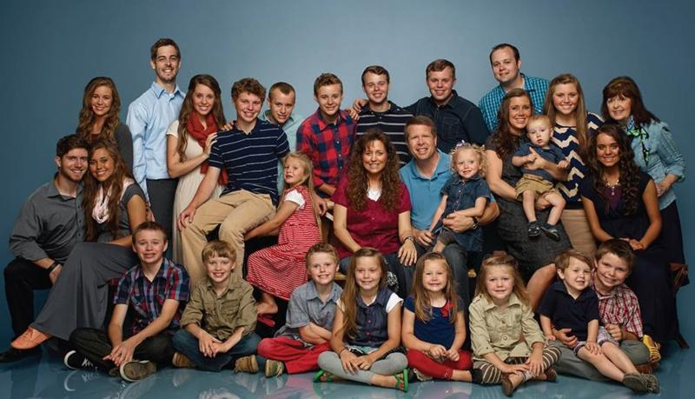
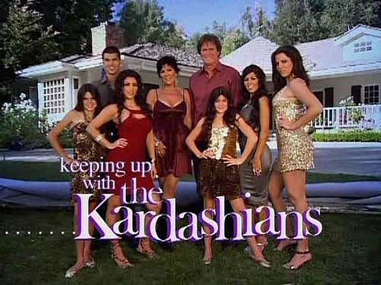
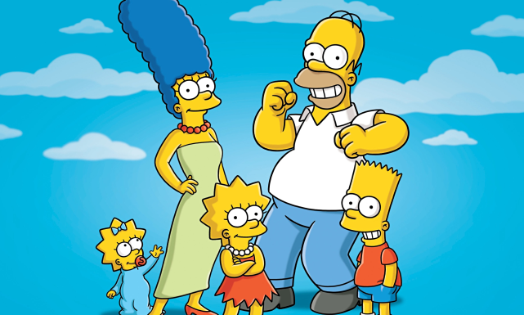
Family Structures
Person or persons who have primary responsibility for the care, nurturing and upbringing of a child (definition for class purposes)
Family largely determines the way culture, heritage and traditions are transmitted across the generations
It is important to be open-minded when working with children and their families and to accept each family’s uniqueness.

Slide 9
“Supporting Cultural and Linguistic Diversity”
https://www.youtube.com/watch?v=XWg-ZrV3wPk

Slide 10
“Why does My identity matter?”
Children will watch every move you make.
They learn about themselves through what they are taught and through observation.
Is what you are modeling (acting, talking, etc) What do the parents want their children learning?

Slide 11
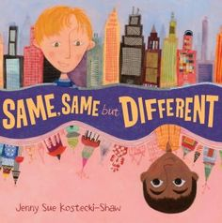
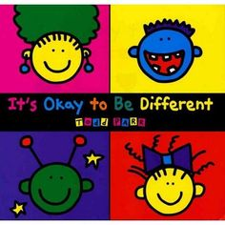
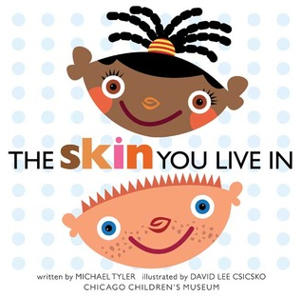
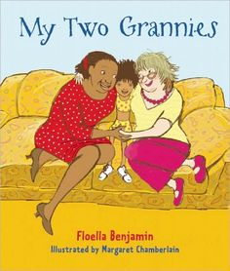
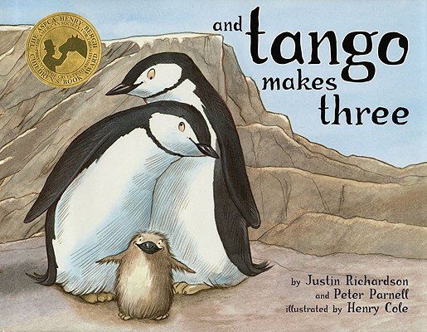
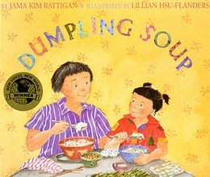
Children’s Books & Family Diversity

Slide 12
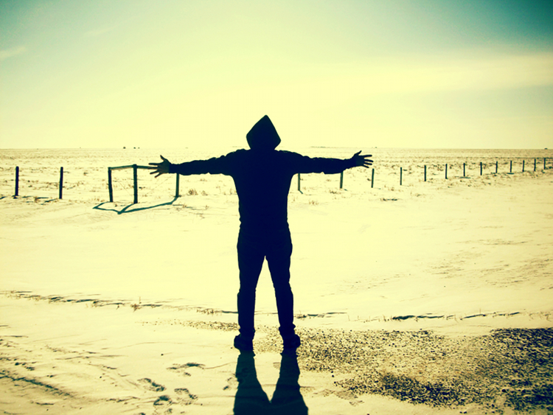
I Am Poems
10 statements starting with “I Am”
At least 5 should be “deep” culture

