Slide 1
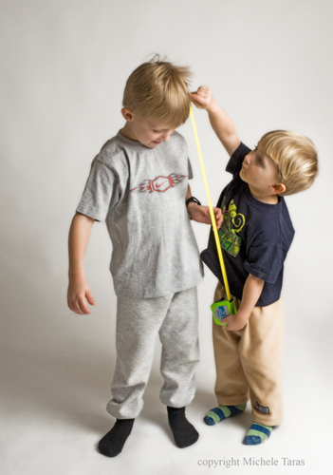
Physical Development
The Preschool Years

Slide 2
Height and Weight Development
Preschool children grow in height/weight more slowly than toddlers or infants (a human being doubles their birth height in the first 5 years of life)
Instead of growing, a preschooler’s body proportions change.
Growth rate slows at a similar pace for all children…so a 3 year old that was taller than other peers at 3, will also still be taller than their peers at 5.
Most preschool children grow 2 ½ to 3 inches per year. There is very little difference between the average height of boys and girls at this age.

Slide 3
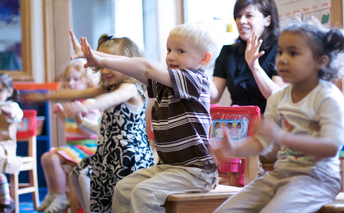
Height and Weight development cont.
Preschoolers generally gain 3-5 pounds per year.
75% of weight gain in preschoolers is because of muscle development.
Boys are generally 1 pound heavier than girls in preschool years.

Slide 4
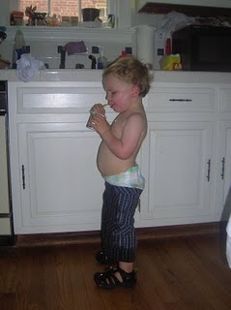
General Body Changes in Preschoolers
Baby features (baby face, especially) begin to disappear. The lower face grows more rapidly than the rest of the head, resulting in a more adult appearance.
The trunk (stomach area) grows to accommodate the internal organs, so the abdomen protrudes less than in the infant/toddler years.
Their legs grow rapidly, and by age 5 will measure close to ½ of their body length.

Slide 5
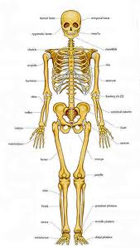
Bones!
The bones continue to ossify (harden) and grow larger and longer.
Deciduous (baby) teeth begin to fall out between ages 4 and 5. (permanent teeth, however, may not erupt until they are in grade school)
Bone development is greatly harmed by malnutrition in these formative years—keep up with the calcium!
Bones are more prone to injury/malformation, but do not break as often as in older children.

Slide 6
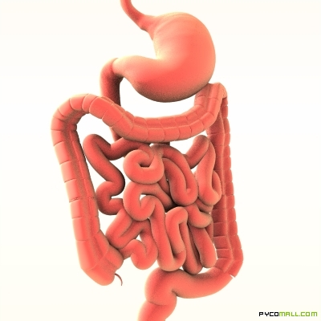
Organs!
The heart rate slows and becomes steady (a baby’s heart beats at 100-150 beats per minute at birth, but by preschool it is down to 70-110, and by adulthood a resting heart rate is between 55 and 85).
The digestive tract is still more irritated by spicy foods and high fiber content (it is slower developing than other organs)
The brain continues to grow and solidify, but it’s rate of growth is much slower than in the first 2 years of life.
Fat tissues continue to lessen—by 5 years of age, the fat tissues of a child are less than ½ the thickness they were at age one.

Slide 7
Gross and Fine Motor Skills
When referring to the physical development of preschoolers, many early childhood professionals refer to their “gross motor” or “large motor” skills, and their “fine motor” or “small motor” skills.
Gross Motor = BIG muscle movements
Running
Jumping
Hopping
Climbing
Skipping
Throwing and Catching
Balancing

Slide 8
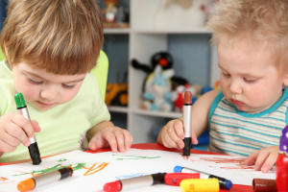
Gross and Fine Motor Skills Cont.
Fine Motor = small muscle motions
Building with blocks
Pouring from a pitcher
Drawing
Writing
Cutting with scissors
Washing hands
Folding paper
Tracing
Lacing shoes
Putting together puzzles

Slide 9
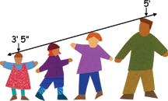
Physical Development by the ages

Slide 10
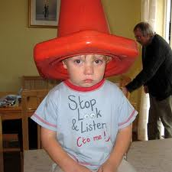
3 year olds...
Can feed themselves with a spoon and fork (still really messy, though!)
Can build towers out of blocks (may have trouble keeping them from tumbling over)
Can draw straight lines
Can copy circles
Can unbutton buttons
Can zip zippers

Slide 11
4 year olds…
Have more control over their movements
May try to use a knife while eating (like cutting up food…not trying to eat using a knife :D)
Can build pretty steady towers of blocks
Can cut along lines with scissors
Can brush their teeth, comb their hair, and wash their hands
They may be able to lace up shoes…but probably not tie them yet

Slide 12
5 year olds…
Have much improved hand-eye coordination
Have selected a right/left hand preference
Use all utensils necessary to feed themselves
Can build and work with blocks with skill
Can make simple drawings freehand
Can fasten buttons and zip zippers
May be able to tie shoe laces

Slide 13
THEEEEEEEE ENDDDDDDD

