Slide 1
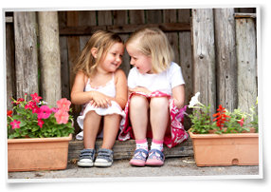
Social development of Children

Slide 2
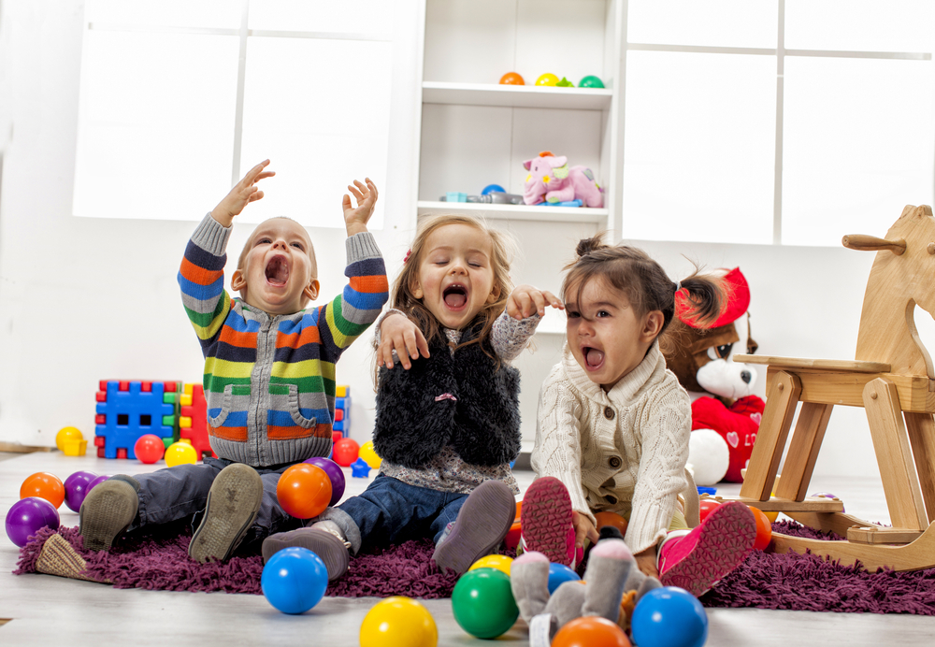
The Social Skills
As young infants/children, we understand how to act by observing those around us
Social Development, in general, involves the ways in which we relate to others.
Social Skills are how we adjust to other people, learn what pleases and displeases them, and how to behave in acceptable ways for our society.
Empathy and communication are also important skills for social development.

Slide 3
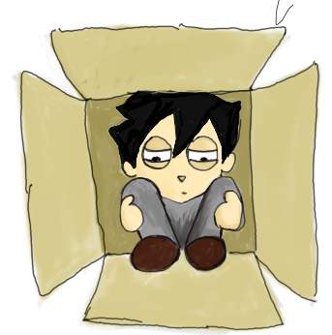
Prosocial/Antisocial
What does anti-social mean to you?
Prosocial: Behavior oriented towards others in a positive manner (i.e. being helpful, cooperative, sympathetic, encouraging, and taking turns).
Antisocial: The absence of social skills (i.e. being aggressive, selfish, disrespectful, and teasing/ridiculing others—”bully” behavior)

Slide 4
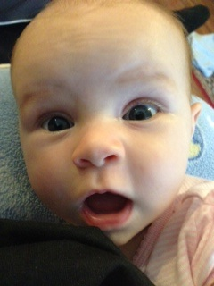
Infant Social Development
Not much until 4 months old
Attachment: A sense of security and trust with another human.
https://www.youtube.com/watch?v=_O60TYAIgC4
Harlow Experiments were horrible,
but they taught us much about
human social development.

Slide 5
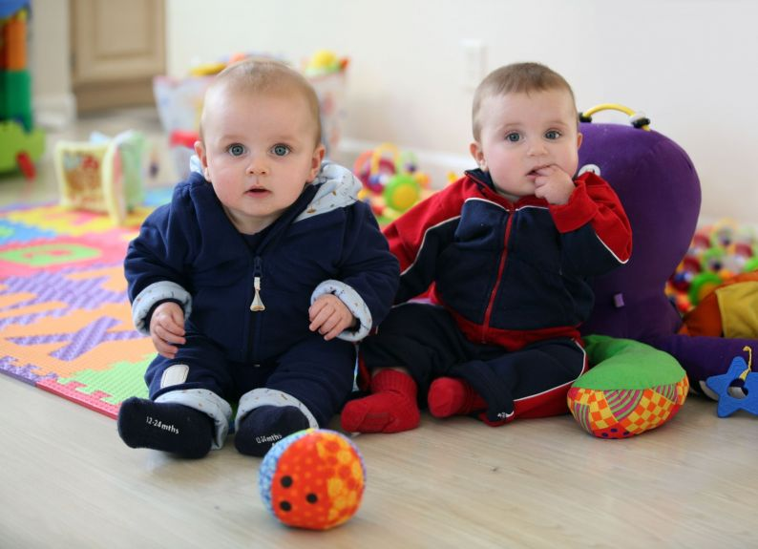
Infant Social Continued!
Separation Anxiety: Crying, or fussy behavior when the attachment figure leaves or is not visible to the infant
Stranger Anxiety: An infant’s
negative reaction to unfamiliar
people.
These are normal infant responses to uncertainty…but they vary in intensity depending on the child.

Slide 6
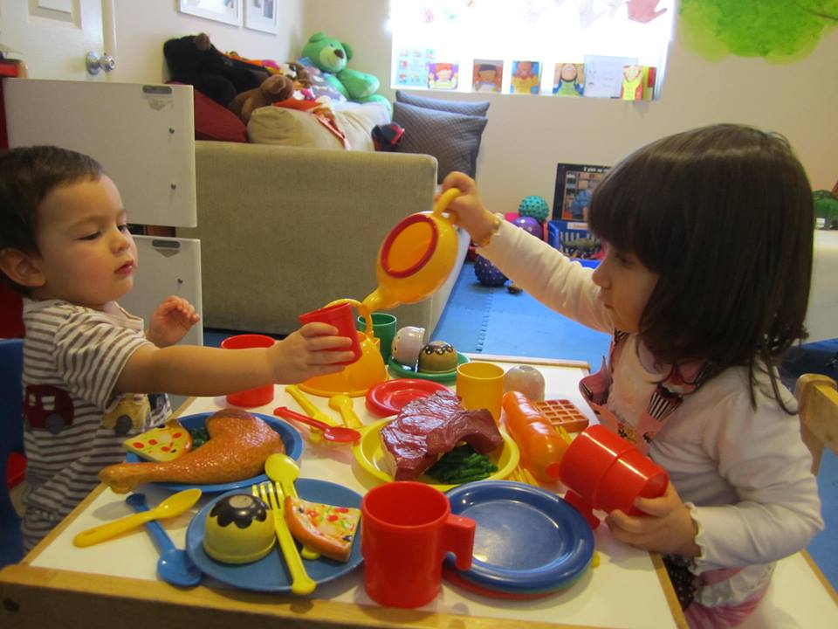
Social In Preschool
Stranger/social anxiety decrease by 2-3 years of age, but still can be present
Autonomy (independence/self-reliance) is growing as the preschooler has more time away from their parents/caregivers.
Language Acquisition (starting to understand a verbal or non-verbal language) allows more freedom to socialize, as children can talk to and play with other children.

Slide 7
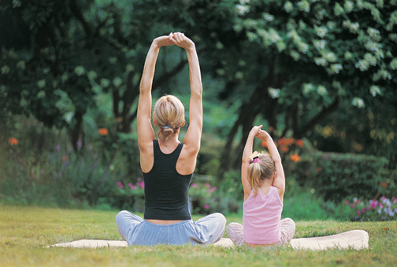
More Preschool Social Dev.
Socialization (the learning of attitudes, values, morals, and rules for appropriate behavior in a given culture) happens as children are exposed to a larger variety of other people and children.
Children learn the most about how to be social and how to behave from people they look up to (role models).

Slide 8
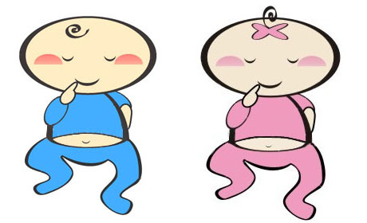
Gender Roles/Identity
At the preschool age children begin to realize that they are girls or boys, which is called Sexual Identity.
Traditional Sex Roles are established in preschool as well, depending on the environment of a child. This is where girls can learn to enjoy traditionally “feminine” activities and behavior, and boys “masculine”.
What do we do in the preschool to maintain these gender roles? What do we do to challenge them?

Slide 9
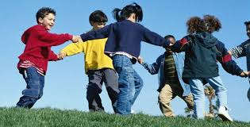
The Peer Group
A child’s peer group is made up of other children who are more or less the same age.
Some functions of peer groups are:
Playmates for shared activities
Sources of encouragement or approval
Language development as they converse
Healthy separation from dependency on parents
Offers a sense of belonging
Helps shape self concepts and self esteem

